Slide 1
PAY AND THE ‘COST OF LIVING CRISIS’
HEATHER WAKEFIELD
UNISON
Notes:
WILL MOSTLY TALK ABOUT LOCAL GOVERNMENT – BUT ALSO REST OF PUBLIC SECTOR
CLEARLY IMPACT OF COALITION CUTS AND LONGER-TERM NEO-LIBERALISM
NEO-LIBRAL IMPACT EVEN IN PARTS OF PUBLiC SECTOR - LG
ATTACKS ON HEALTH (PRB)
TEACHERS (PRB)
ALSO POLICE STAFF AND PROBATION
AND CIVIL SERVICE
NOT TO MENTION OUTSOURCED SERVICES WHERE TWO-TIER CODE GONE. HOME CARE WORST EXAMPLE
BUT WORST IN LG – ALSO IMPACTING ON CONTRACTING OUT
WILL SHARE RECENT UNISON SURVEYS AND EVIDENCE
AND THEN DISCUSS SOME OF THE ISSUES BEHIND THE HEADLINES

Slide 2
THERE IS A CRISIS…HONEST
85% SAY WORKLOAD AND PRESSURE UP
70% SAY STRESS AFFECTING PERSONAL LIFE
44% STRUGGLING TO MAKE ENDS MEET
87% CUT PERSONAL/ENTERTAINMENT SPEND
77% HAVE CUT SPENDING ON FOOD
DEBT INCREASED FOR ALMOST 60%
94% SAY ‘RECOVERY’ ONLY/MAINLY BENEFITTING WELL-OFF
94% SAY 1% PAY OFFER UNFAIR/DEEPLY UNFAIR
Notes:
1699 MEMBERS 75% LG, 20% SCHOOLS
LAST TWELVE MONTHS (UP TO AUGUST 2014)
UNDER-REPRESENTS MANUAL WORKERS

Slide 3
‘PUBLIC SECTOR PAY’ ISSUES
‘PAY’ - MORE THAN ANNUAL PAY ROUND
PAY ‘CRISIS’ MULTI-FACETED
NO SUCH THING AS ‘PUBLIC SECTOR’ PAY
PAY DETERMINATION ARRANGEMENTS
GENDER A HUGE PUBLIC SECTOR ISSUE
IMPACT OF PRIVATISATION ON ‘PUBLIC SERVICE’ PAY
Notes:
WANT TO SUGGEST THAT ‘PUBLIC SECTOR’
‘PAY – AS DEFINED IN EURO LAW -TO INCLUDE CONTRACTUAL ENTITLEMENTS
SO ANNUAL PAY ROUND JUST ONE ASPECT OF FIGHT FOR DECENT INCOMES
WIDE VARIATION IN PAY RATES FOR SAME/SIMILAR WORK WITHIN PUBLIC SECTOR
AND AT TOP END..AFC ENDS AT £98K, NJC AT £49K
ALSO CONDITIONS
GOVERNMENT/LABOUR APPROACH TO PAY UNFAIR AND BLUNT INSTRUMENT
GOVERNMENT PAY POLICIES NOT UNIFORMLY APPLIED
ALSO MEANS OF DETERMINATION DIFFERENT
SOME PRB’S – EVEN IF IGNORED!POLICE, NHS, TEACHERS
POLICE SUPPORT STAFF, SCHOOLS, PROBATION BY LGA
RESOUCES DIFFER WIDELY + ‘BUY IN’ PROBLEM
65% ALL PUBLIC SECTOR STAFF WOMEN
75%+IN LG, NHS AND TEACHING/EDUCATION
HIGH PROPORTION OF PART-TIMERS
GENDER PAY GAP IMPORTANT FACTOR FOR WOMEN’S PAY AND DECLINE IN PAY
UNDERMINING OF EQUAL PAY PROOFED AGREEMENTS
IMPACT OF MARKET PAY AND END OF TWO-TIER CODE+CUTS
* CONTRACT/EP LAW WEAK, IA LAW COMPLEX, NO SECTOR-WIDE BARGAINING
* FINANCE/CUTS VARY

Slide 4
WHAT’S HAPPENED TO PAY, CONDITIONS AND WORK?
DECLINE IN BASIC PAY
MINIMUM WAGE THE NORM?
CUTS TO CONDITIONS
AND PENSIONS
EQUAL PAY BEING ERODED
INTENSIFICATION OF WORK
OUTSOURCED SECTORS EVEN WORSE
Notes:
SO…LET’S LOOK AT WHAT’S HAPPENED TO PAY AND CONDITIONS
DECLINE IN REAL TERMS ACROSS THE PUBLCI SECTOR
NOT UNIFORM – LG WORST
450,000 BELOW LIVING WAGE
1 MILLION BELOW £21K
61% PART-TIME/90% WOMEN
PUBLIC SECTOR PAY FREEZE – 3 YEARS IN LG
NOT PAID £250
NMW PROBLEM THIS YEAR
103 COUNCILS PAY LIVING WAGE - THOUGH OFTEN IMPOSED OR MESSES UP EQUAL PAY SYSTEMS
PESNIOSN – CONTRIBUTION INCREASES ETC
INTENSIFICATION OF WORK – PART-TIMERS SURVEY
STRESS
UNPAID OVERTIME
OUTSOURCED SECTORS – HOME CARE, CATERING , CLEANING

Slide 5
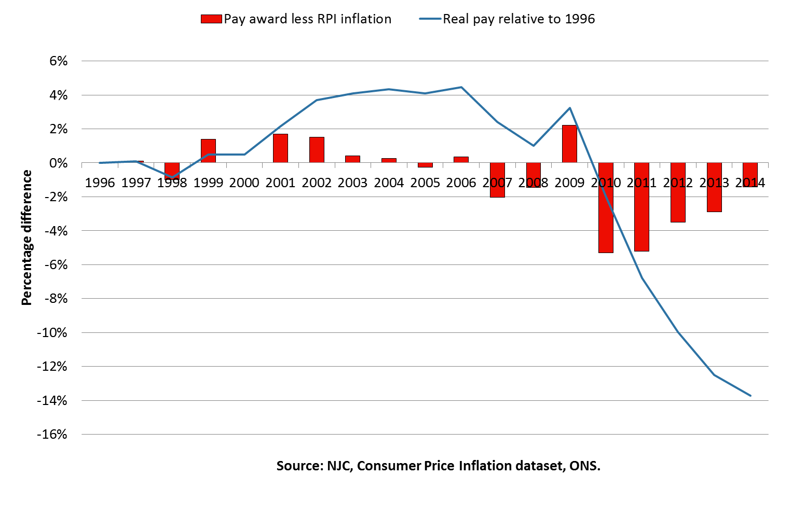
NJC PAY SINCE 1996
Notes:
LONG TERM DECLINE
PAY SETTLEMENTS BELOW INFLATION IN 9/19 YEARS
PERIOD SINCE SINGLE STATUS
LABOUR IN POWER UNTIL 2004
MARKED EFFECT SINCE COALITION PAY FREEZE IN 2010,2011, 2012
THEN 1% increase plus this year’s offer

Slide 6

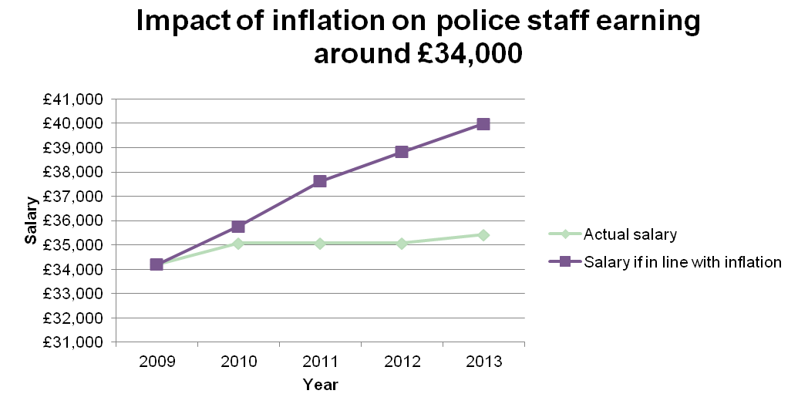
Falling value of police staff wages
Notes:
This graph demonstrates the same pattern at the other end of the police staff salary scale
For police staff on a current salary of £35,427, real inflation would add around £4,600 to the value of the 2013 wage and if the impact on wages in 2010, 2011 and 2012 are considered, the total loss of earnings adds up to around £11,600

Slide 7
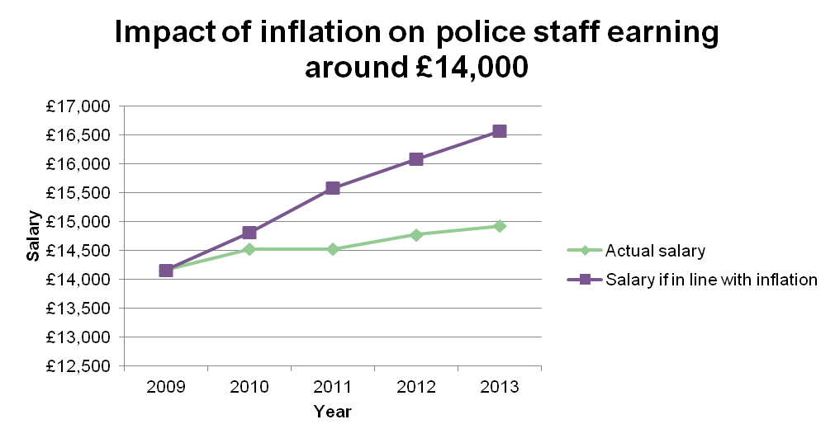
Falling value of police staff wages
Notes:
This graph sets out the impact of inflation on the value of wages for police staff at salary point four, currently worth £14,928
The green line shows how their actual salary has changed between 2009 and 2013
The purple line shows how their salary would have grown if it had kept pace with inflation
In other words, for the 2009 salary of £14,163 to have the same buying power in 2013, it would need to stand at £16,564
In reality, it stood at £14,928
Therefore, inflation has stripped around £1,600 out of the value of the 2013 wage and if the impact on wages in 2010, 2011 and 2012 are considered, the total loss of earnings adds up to around £4,300
The purchasing power of police staff salaries is down 13% since 2010
There was no pay rise at all for most police staff in 2011 and 2012
There was only a 1% pay deal in 2013

Slide 8
UNISON LG PART-TIME WORKERS SURVEY
20% PART-TIME AS NO FULL-TIME JOBS
40% TO JUGGLE FAMILY RESPONSIBILITIES
75% BELOW UK MEDIAN EARNINGS IN 2013
60% WORK REGULAR UNPAID OVERTIME
LONGEST HOURS SLASHED SINCE 2010
MANY DOING FULL-TIME WORK ON PART-TIME PAY
MASSIVE CUTS TO CONDITIONS
27% RECEIVED NO TRAINING
Notes:
* ALMOST 3000 RESPONDENTS

Slide 9
TRADE UNION RESPONSE
WEAK ?
NOT HELPED BY LABOUR
DIFFERENT ACTION ACROSS UNIONS AND SECTORS
LONG-TERM BUT DWINDLING ACTION IN SOME
‘PATCHY’ ACTION IN OTHERS
SOME LOCAL ACTION AGAINST CUTS TO CONDITIONS
FOCUS ON LIVING WAGE AT LOCAL LEVEL
EQIA’S HELP IN SOME PLACES

Slide 10
WHY NOT STRONGER RESISTANCE?
FEAR – REDUNDANCIES, PAY CUTS
SHIFT FROM BARGAINING TO ‘ORGANISING’
FOCUS ON LIVING WAGE
LOW MEMBERSHIP AND DENSITY
LOSS OF CONFIDENCE IN COLLECTIVE BARGAINING
PRIVATISATION AND FRAGMENTATION
COMPLEX IA LAW AND BALLOT REQUIREMENTS
WEAK LEADERSHIP?
Notes:
INTERESTING RESULT IN POLICE SUPPORT STAFF – 88% VOTED TO REJECT OFFER AND GO FOR STRIKE ACTION
BUT LOW TURNOUTS IN IA BALLOTS
‘TRADITIONAL’ AGENDA NOT ATTRACTIVE TO SOME WHO SEE NEED TO ORGANISE MORE IMPT THAN PAY ETC
BARGAINING MACHINERY HASN’T DELIVERED – THREAT OF ‘GOING IT ALONE’ – REGIONAL AND NATIONAL (WALES)
MAJOR PROBLEM WITH LOW MEMBERSHIP/DENSITY – JUST 50% BUT MUCH LOWER IN SOME REGIONS
HARDER TO MOBILISE IN SE, EAST AND SW – COINCIDES WITH DENSITY AND TORY POLITICS
PRIVATISATION HAS TAKEN OUT KEY SERVICES – FINANCE, REFUSE, SCHOOL MEALS
FRAGMENTATION OF SCHOOLS

Slide 11
SO WHAT IS TO BE DONE?
NOT JUST POLITICAL SOLUTION…
REQUIRES COMPLEX RESPONSE
INQUIRY INTO PUBLIC SECTOR PAY
ISSUES WITHIN AND ACROSS UNIONS
COLLECTIVE BARGAINING FRAMEWORK
LEGAL REFORM
WAGE REGULATION AND ENFORCEMENT
PRODUCTIVITY?
Notes:
LABOUR COMMITMENT TO 1% ‘PUBLIC SECTOR PAY’ POLICY
FURTHER CUTS
WITHIN UNIONS - NEED TO:
BE SMARTER OVER TACTICS
CAN WE SUSTAIN ALL-OUT ACTION? SELECTIVE?
PRIVATISATION PROBLEM
BUILD MEMBERSHIP AND DENSITY
HAVE CAPACITY TO BALLOT/SUPPORT ACTION
LEADERSHIP?
LABOUR LINK
DEVOLUTION ISSUE
GENDER DISCRIMINATION – FEMALE WORKFORCE DOING EMOTIONAL LABOUR AND SERVICING WORK
GOVERNANCE OF PUBLCI SERVICES - MALE POLITICIANS AT NATIONAL AND LOCAL LEVEL
DOMESTIC POLITICS BROUGHT INTO WORKPLACE
NEED STRONGER EQUAL PAY, PART-TIME, DISCRIMINATION LAWS AND RESTORED PUBLIC SECTOR EQUALITY DUTY WITH TEETH!
STRONGER CONTRACT LAW
INDUSTRIAL RELATIONS/ACTION
COLLECTIVE BARGAINING – AT SECTORAL LEVEL/ EG EWING AND HENDY?
WHITLEY COUNCILS – SINCE WW1!
THOUGH EQUAL PAY ISSUE
TO INCLUDE TRAINING, EQUALITY , HEALTH AND SAFETY
COLLECTIVE AGREEMENTS WITH TEETH
LIVING WAGE TO BE THE MINIMUM RATE FOR ALL – NOT DEPENDENT ON CAMPAIGNING
PRODUCTIVITY CONUNDRUM…HOW CAN MANY PUBLIC SECTOR WORKERS BE MORE PRODUCTIVE? HOME CARE ETC

